Slide 1
companies with more than $1B in cash have a significant difference in returns by the end of the year
GAUKHAR JAVAROVA

Slide 2
agenda
Introduce the data
Is there a significant difference?
By how much?
What’s the use of the hypothesis?

Slide 3
Data analyzed
40,000 companies from the end of the Q1 2018 to the end of Q1 2019
Data includes ticker name, price, cash/assets, calendar date.
Raw data can be found here: Quandle_data

Slide 4
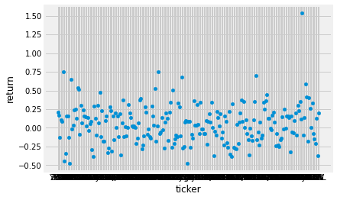
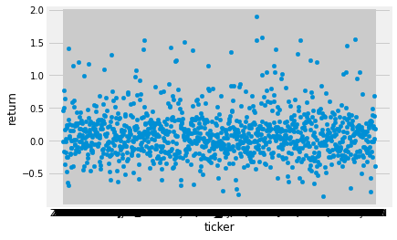
Is there a significant difference?
More than$1B
Less than$1B
237 companies
1103 companies

Slide 5
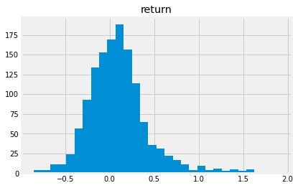
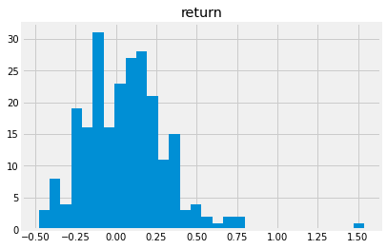
By how much?
There was a significant difference in returns between the 2 groups, this difference is showing that ‘cash weak’ performed 1% - 8% better than ‘cash rich’ as shown by a 95% confidence interval.
Cash weak companies
Cash rich companies

Slide 6
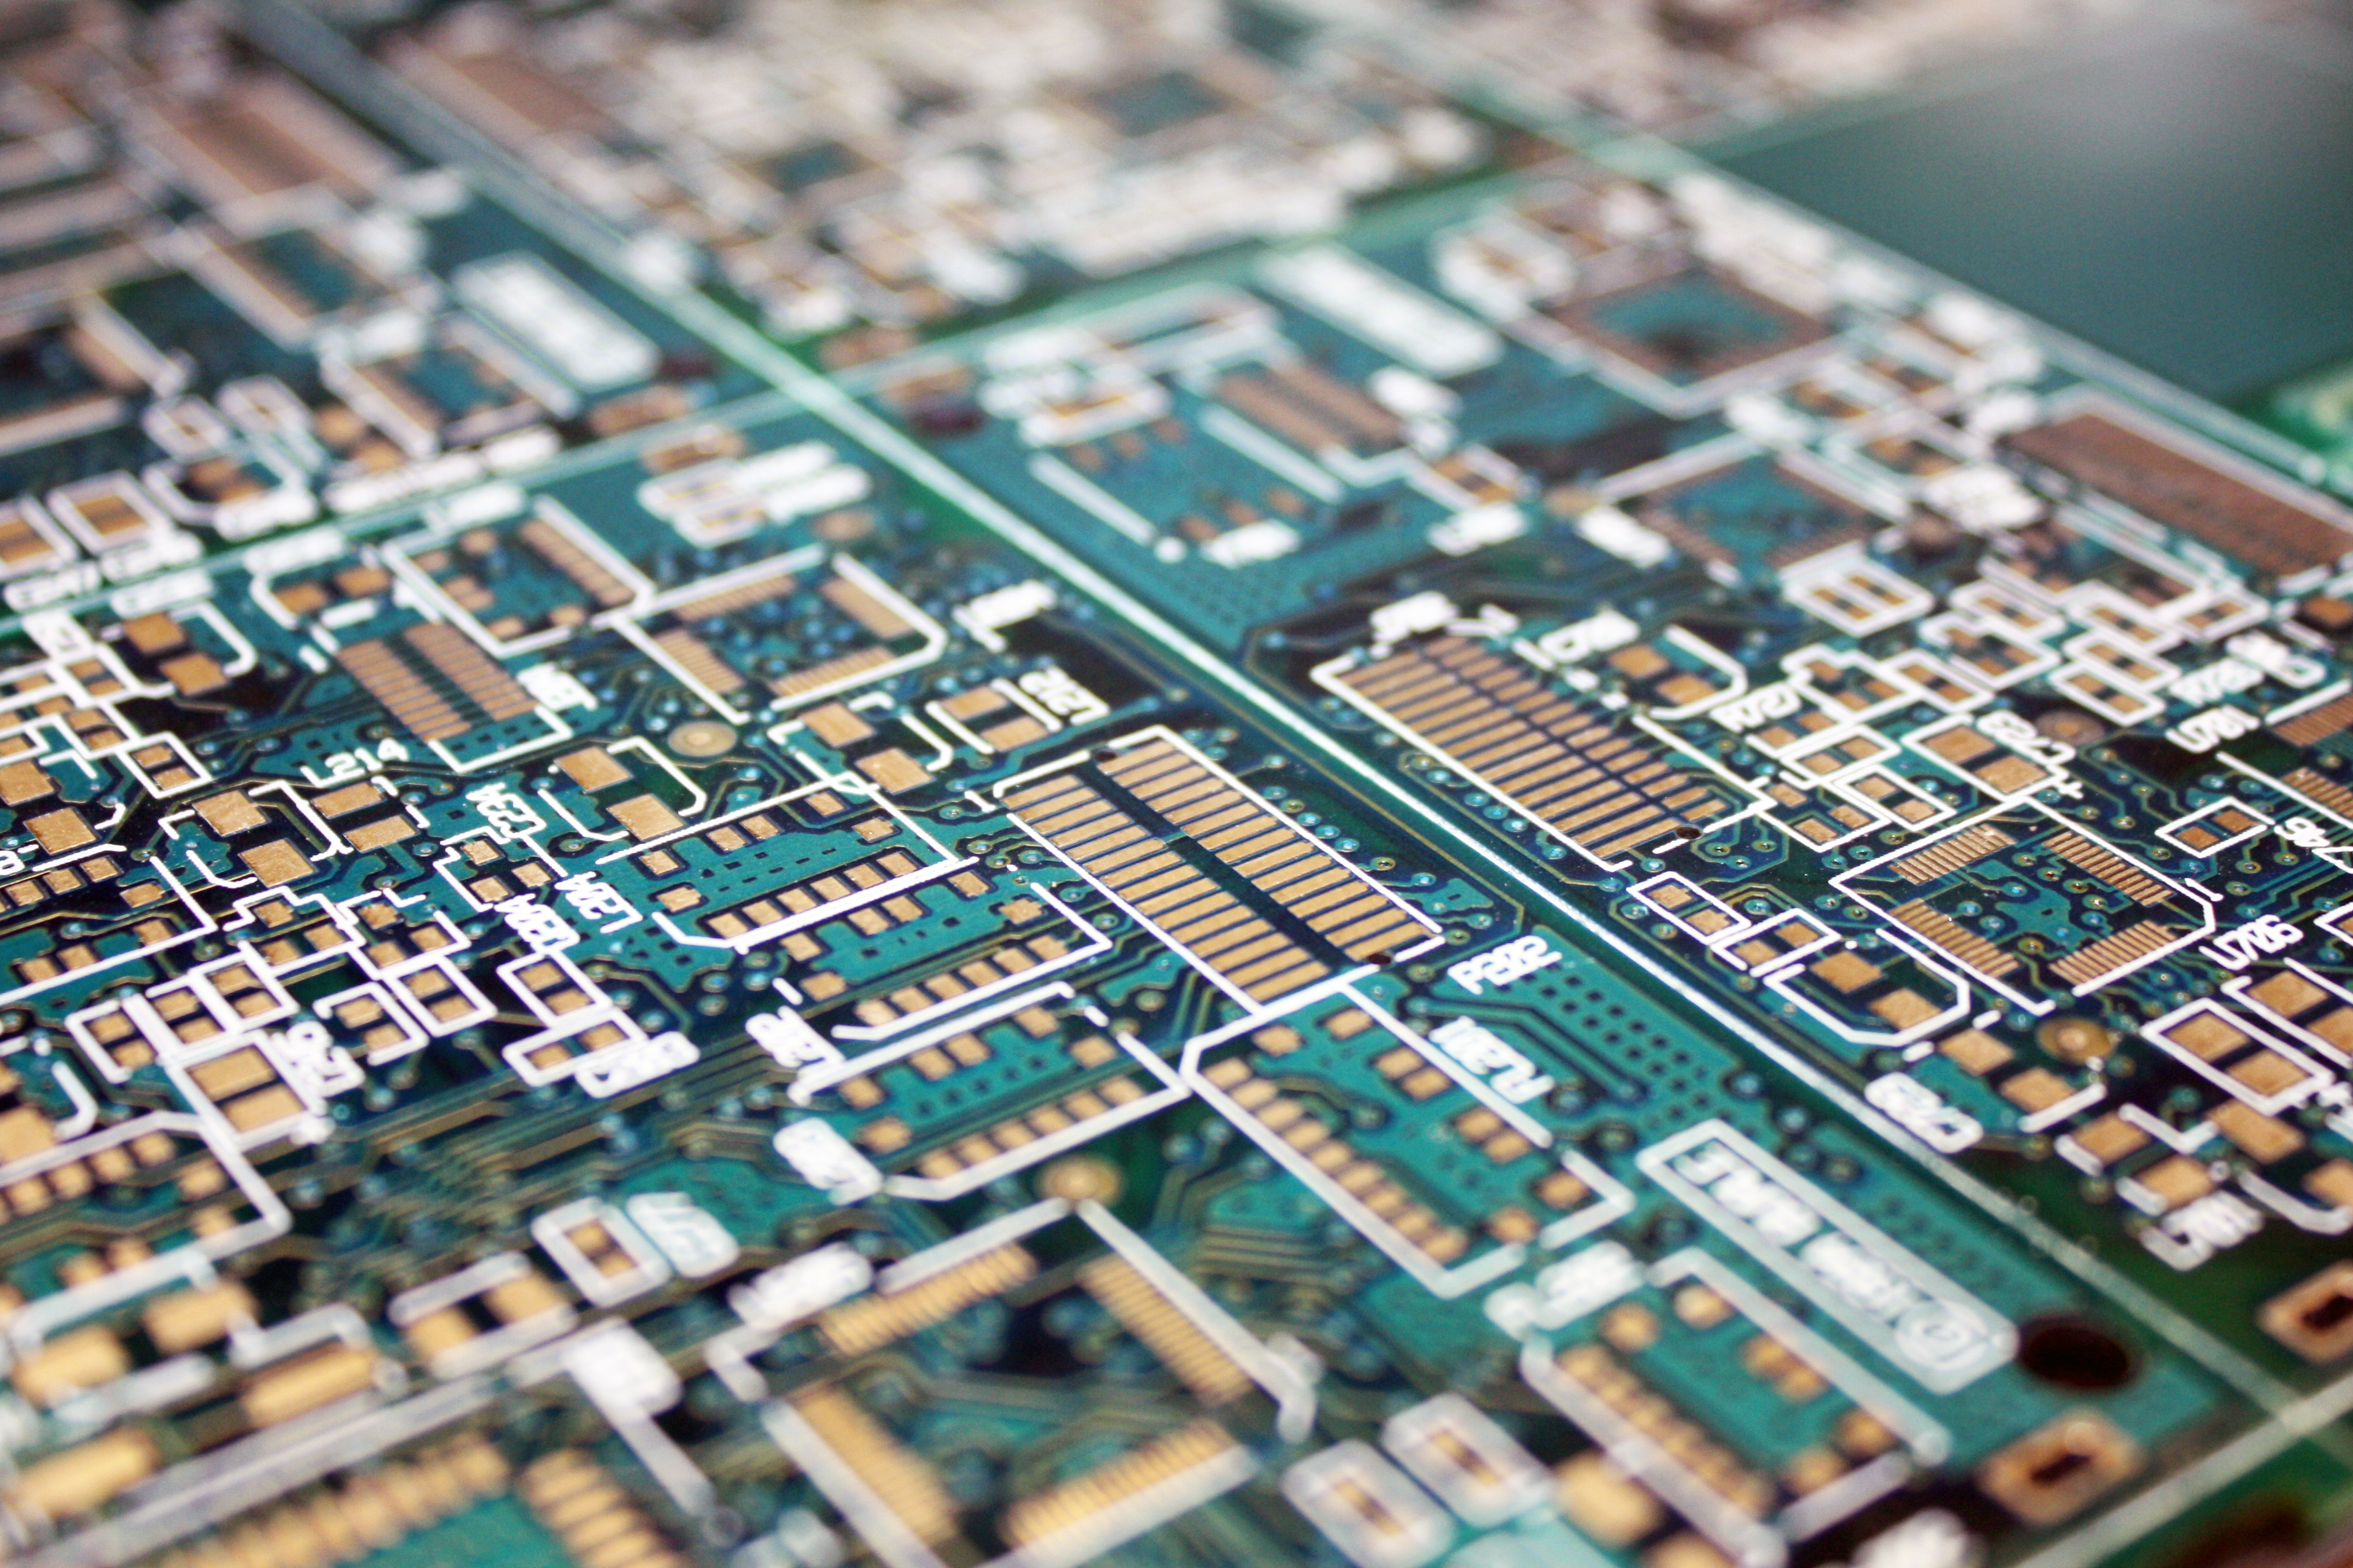

What’s the use of this information?
‘Cash rich’ AMD made > 150%
Great valuable, stable stock for long term hold
‘Cash weak’ GLUU made > 190%
This is a low risk / high reward stock
Both are tech companies

Slide 7
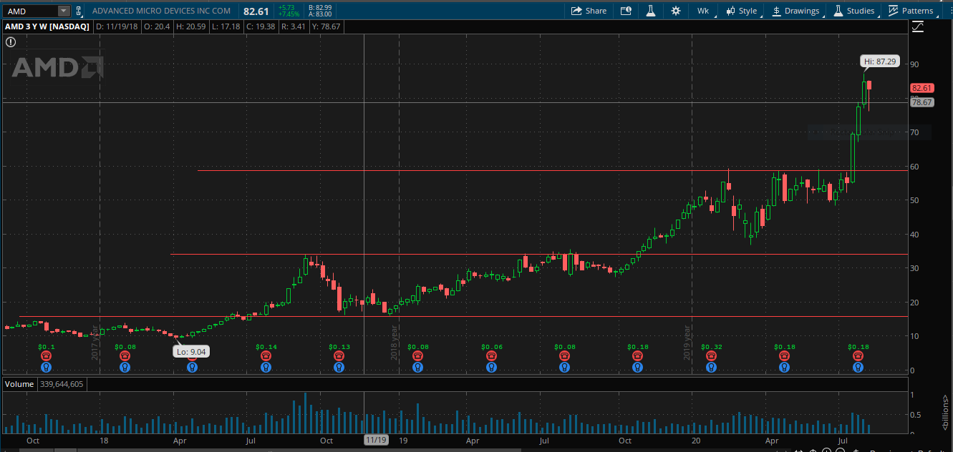
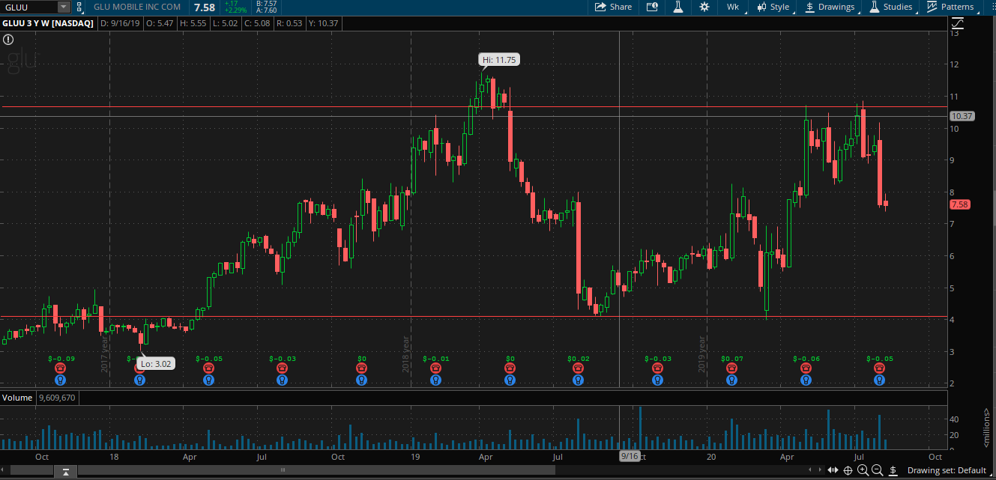
Buy GLUU at ~ 4$, cut loss at 3.80, sell half at $7 and half at $10
My suggestion is to buy AMD at $60s and hold, cut loss at $48

Slide 8
Questions?
THANK YOU!

